Slide 1

FOOD ADULTERATION

Slide 2

FOOD ADULTERATION

Slide 3
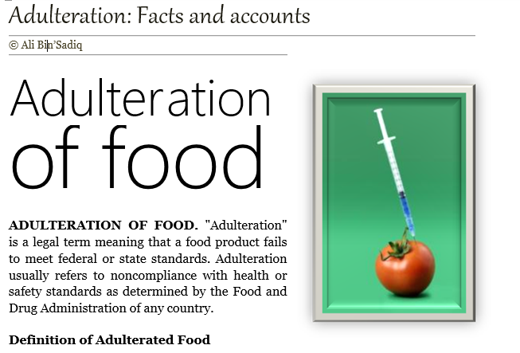
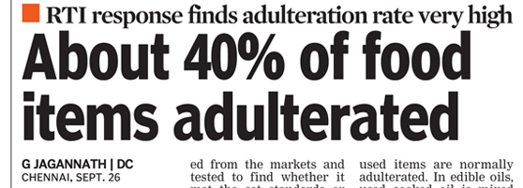

Slide 4
DIFFERENCES BETWEEN ADULTERATION AND CONTAMINATION
While both are terms that refer to unfavourable conditions with regards to substances that are used in day-to-day life,
Adulteration and Contamination share certain differences that set them apart.

Slide 5
DIFFERENCES BETWEEN ADULTERATION AND CONTAMINATION
Adulteration stands for the addition of certain ingredients that are not legally permitted in them.
Contamination stands for the deterioration of the quality of the substance.

Slide 6
DIFFERENCES BETWEEN ADULTERATION AND CONTAMINATION
Adulteration is performed as a practice by certain merchants to obtain more profit.
Contamination is not performed as a practice.

Slide 7
DIFFERENCES BETWEEN ADULTERATION AND CONTAMINATION
Adulteration is mostly man-done.
Contamination can happen naturally as well as a result of environmental factors such as heat, humidity etc.

Slide 8

REGULATORY AGENCY

Slide 9
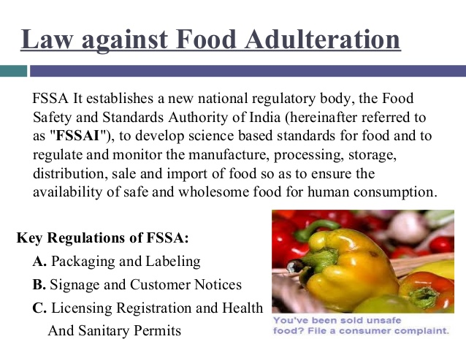

Slide 10

REGULATORY AGENCY

Slide 11
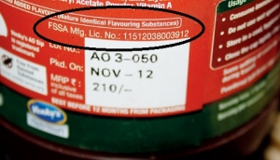
REGULATORY AGENCY

Slide 12
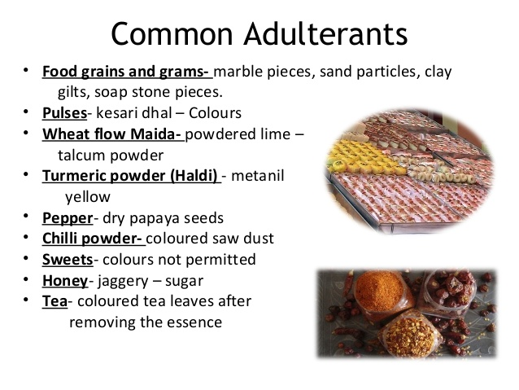

Slide 13
